Slide 1
How a Project to Digitize Legacy Paper Records Can Be Used as the Basis for a Transit System Knowledge Graph
Joseph Busch

Slide 2
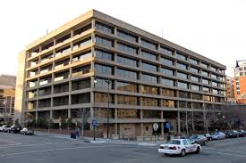
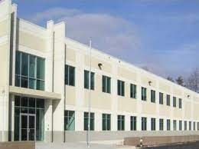
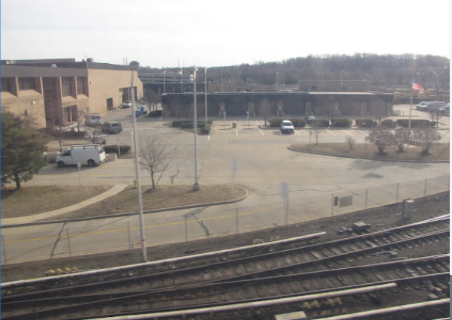
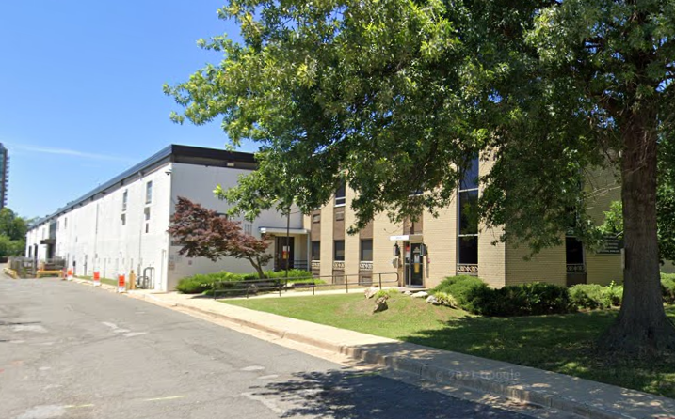
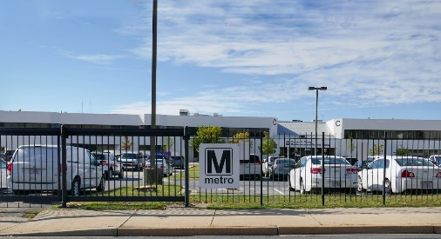
Project background
  Situation at a major regional transit authority
    3,000 office-based employees spread across more than 10 aging buildings.
      Deferred maintenance costs
      Safety issues
      Fragmented workforce

Slide 3
Goals, challenges, and solution
  Goals
    Consolidate workforce in 3 regional buildings
    Break down silos and encourage collaboration among departments and teams
  Challenges
    New ways of working and space types (hoteling seating, collaboration areas, etc.)
    Limited space for personal materials (paper files, reference materials, etc.)
  Solution
    Change management, engagement, and communications
    Eliminate legacy paper records and reference materials
      Develop metadata strategy (aka taxonomy), do scanning, and build repository

Slide 4

Accidental digital transformation
  The pandemic caused the Authority to make an abrupt shift to remote work from home
  So the focus of this engagement shifted to helping a bureaucracy which had no culture of remote work be able to work remotely
  … literally overnight.

Slide 5
Enterprise taxonomy process in this project
  Bottom up organizational survey
    Survey each department
    Interview dept stakeholders
    Define dept use cases, metadata, and vocabularies (the taxonomy)
    Validate taxonomy with department
    Generate specification for department
    Apply best practices and emerging commonalities to each Department taxonomy sequentially
Survey Documents
Interview Stake-holders
Draft Taxonomy
Review Discovery
Validation
Analyze
Validation
Prepare Spec

Slide 6
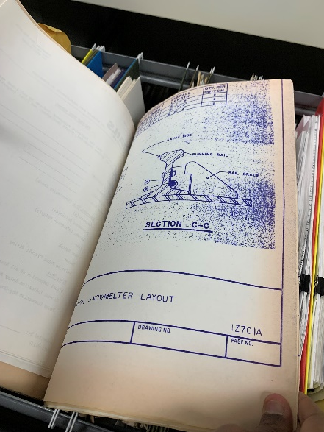
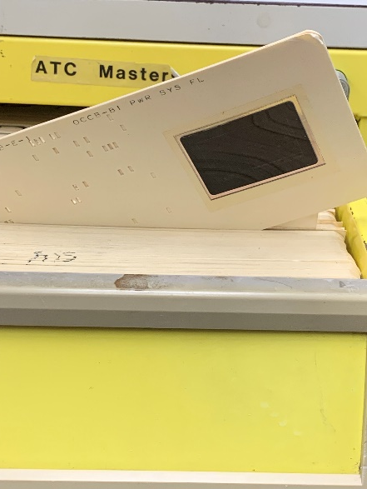
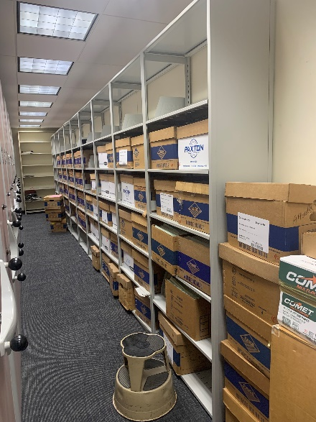
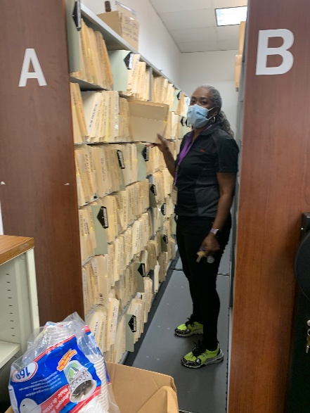
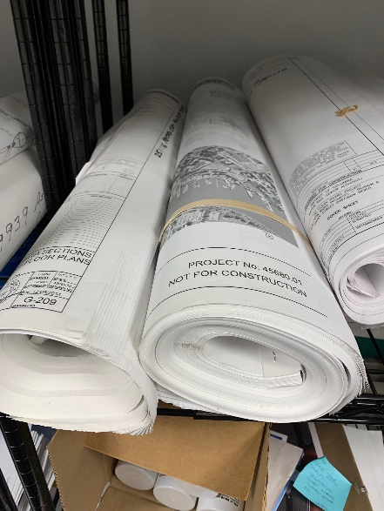
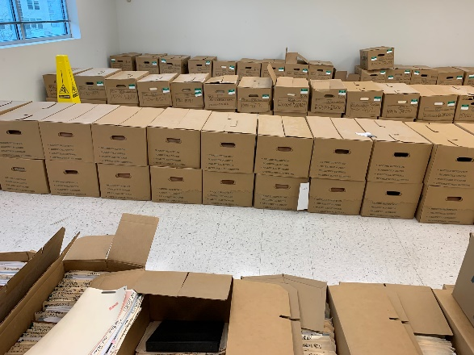
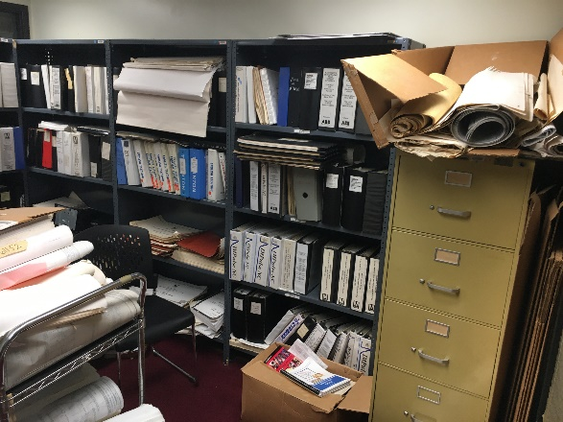
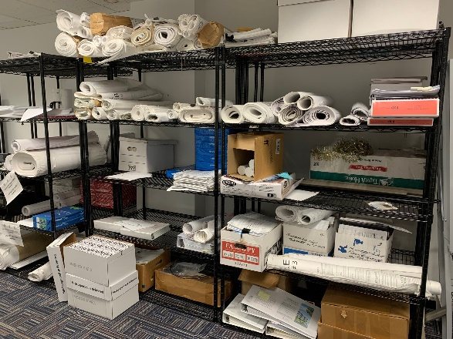
Document survey
Drawings
Aperture Cards
Contracts
Personnel Files
Plans
Claims
Binders
Oversized Materials

Slide 7
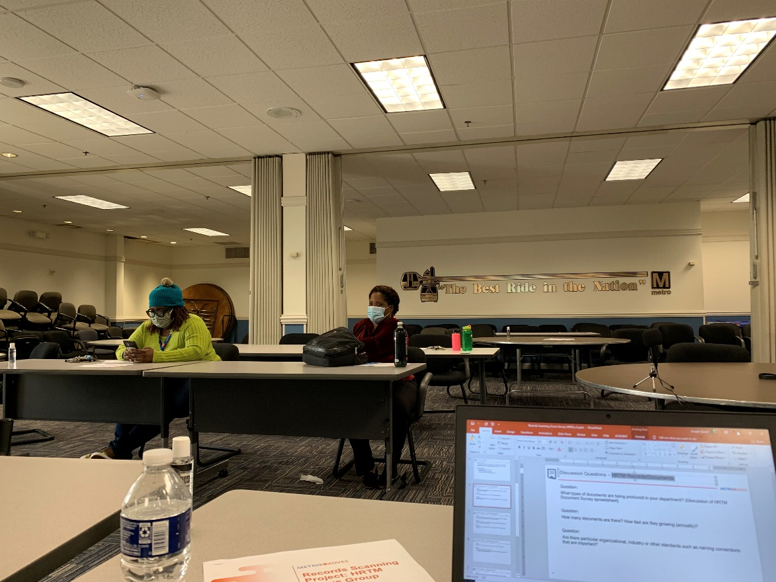
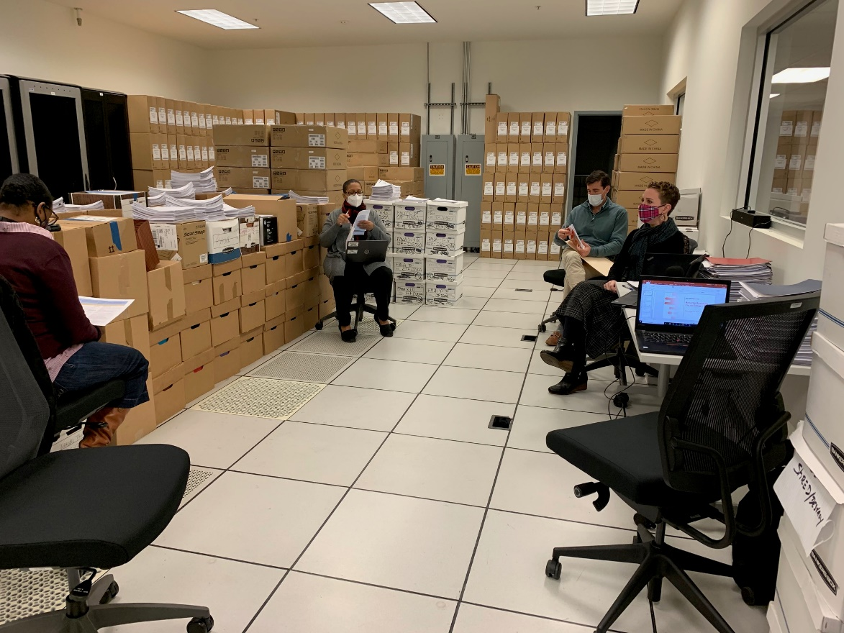
Stakeholder interviews

Slide 8
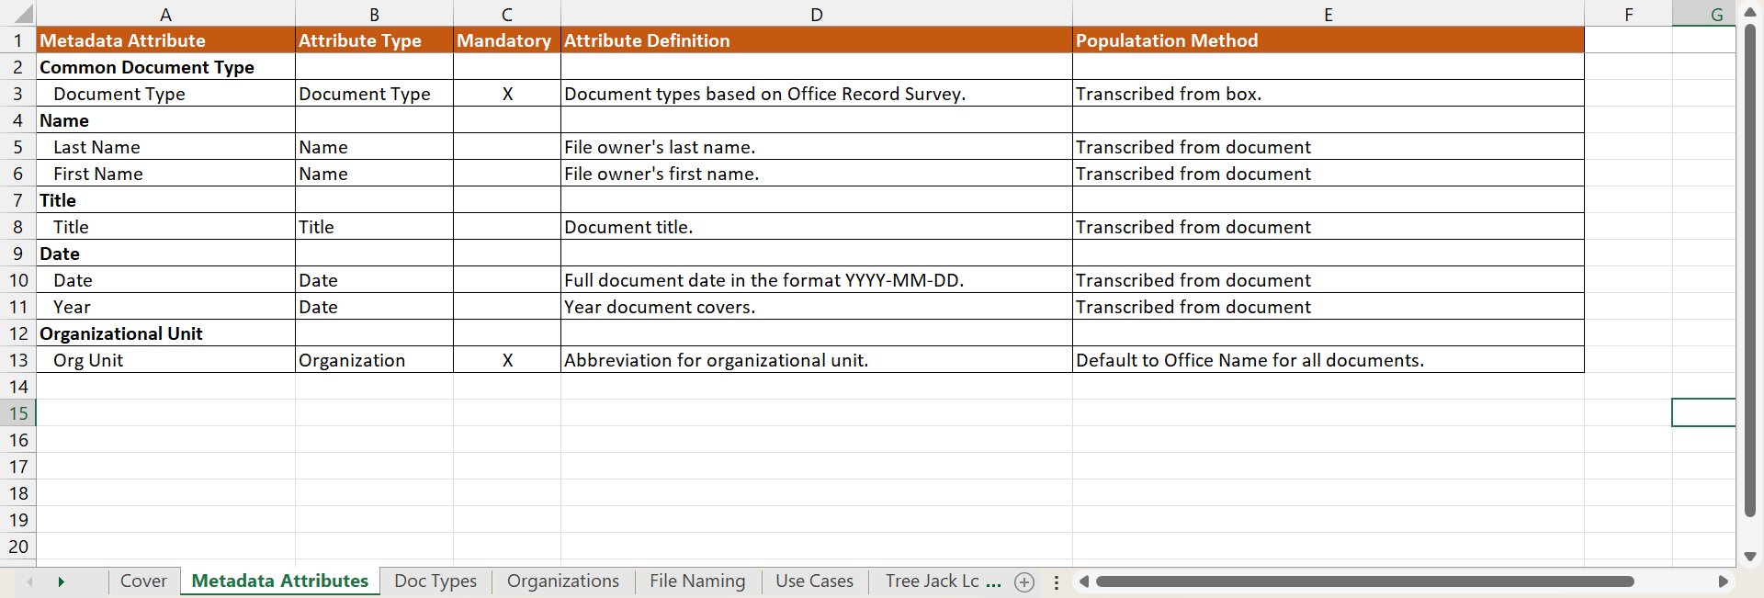
Draft taxonomy template

Slide 9
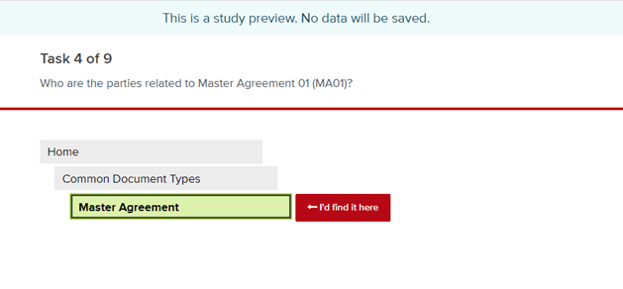
Validation

Slide 10

Digitization specification
Notes:
Replace with anonymous cover slide

Slide 11




Project team

Slide 12
Project demographics
Overall
Most common attributes
  63 Departments participated
  2 years (Oct 2020-Oct 2022)
  Average of 2.6 Departments per month
  Average of 9.6 attributes per Department
  Document Type and Business Unit were mandatory attributes for every Department
Attr Type | Attribute Name | %
Date | Date (MM/DD/YYYY) | 59%
Name | Last Name | 52%
Name | First Name | 51%
Identifier | Contract# | 25%
Identifier | Employee/Contractor ID | 40%
Subject | Title | 40%
Date | Year | 37%
Location | Line/Station Code | 25%
Name | Vendor/Manufacturer | 25%
Date | Month/Year | 21%

Slide 13
Things, Not Strings
  Introducing the Knowledge Graph: things, not strings
    May 16, 2012
    Amit Singhal,
  “In other words, Google would return what is known as structured information about people, places, events, movies, and other concepts, not just the traditional list of web links containing words matching the search terms.” -- Friedrich Lindenberg

Slide 14
Named entity and identifier relationships
Names
Identifiers
  Business Units
  Employees/Contractors
  Vendors/Manufacturers
  Line-Station/Bus Stop (Direction)
  Train Line/Bus Division
  Employee ID (BI#/LBI#)
  Contract#/Mod# (RFP#)
  Line-Station Code/Bus Route
  Train Car#/Bus#
  SOP# (P/I#, Policy#)
  Task Order/Job Code#/Work Order#

Slide 15
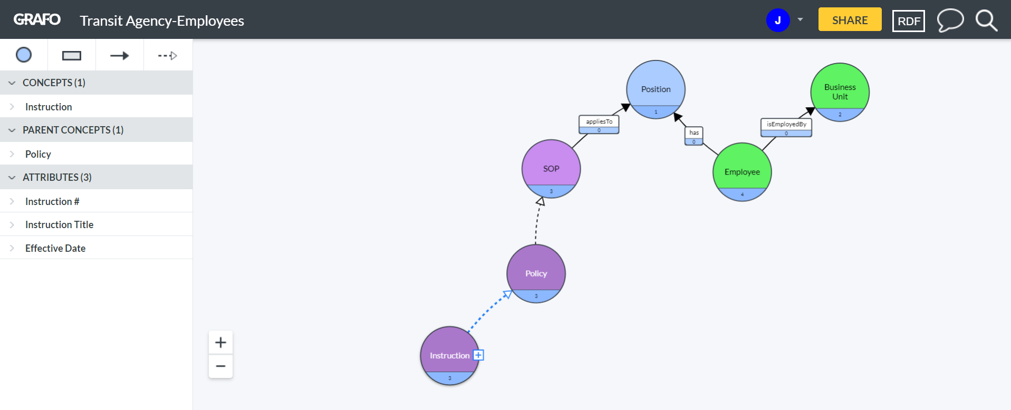
Graph of relationships between employees and policies

Slide 16
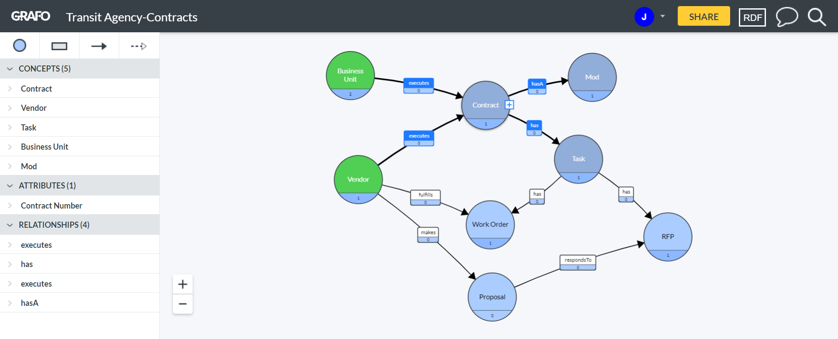
Graph of relationships between vendors and contracts

Slide 17
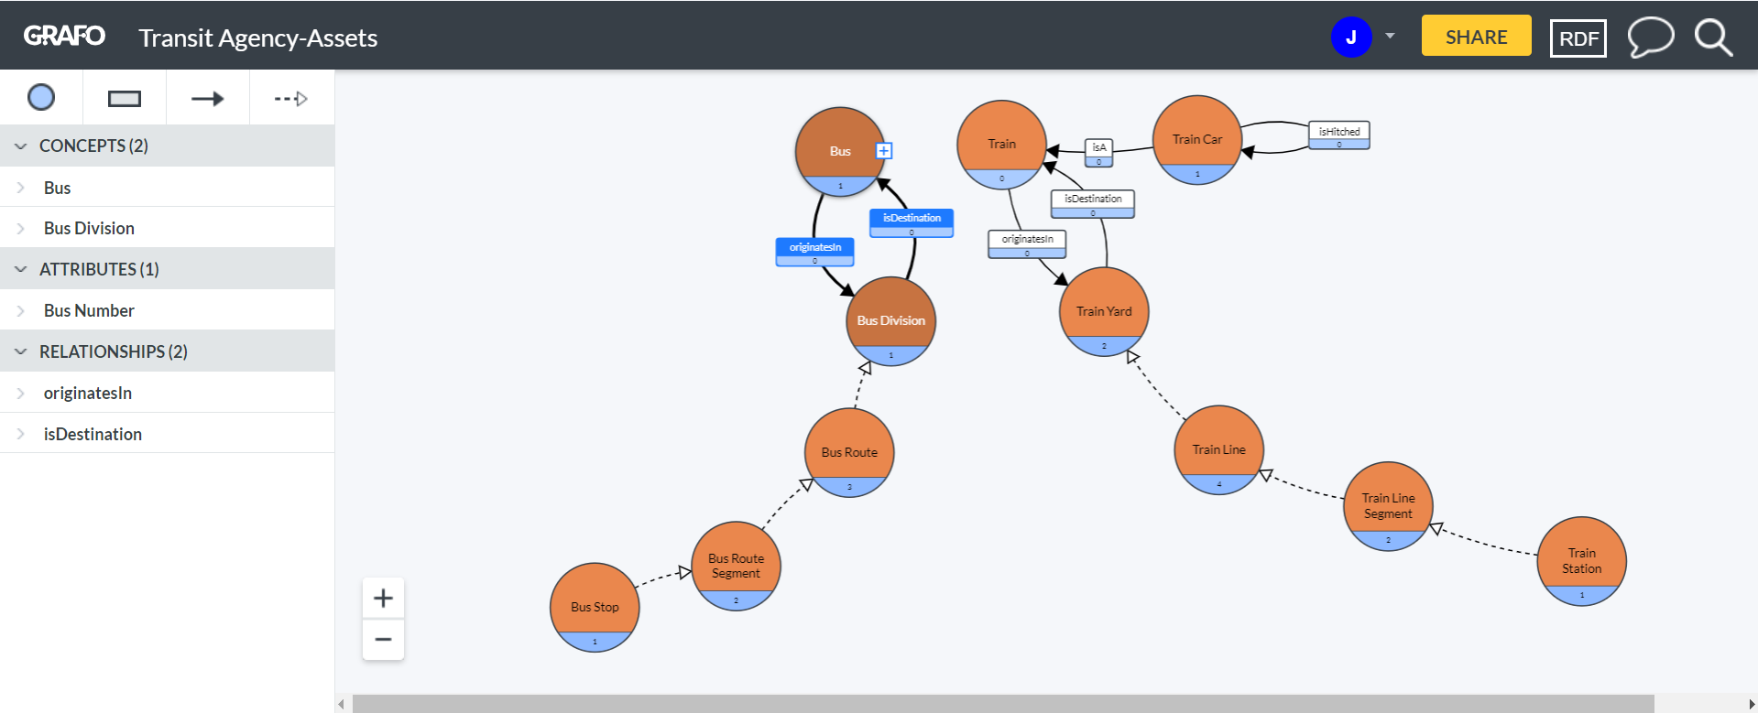
Graph of relationships among transportation assets

Slide 18
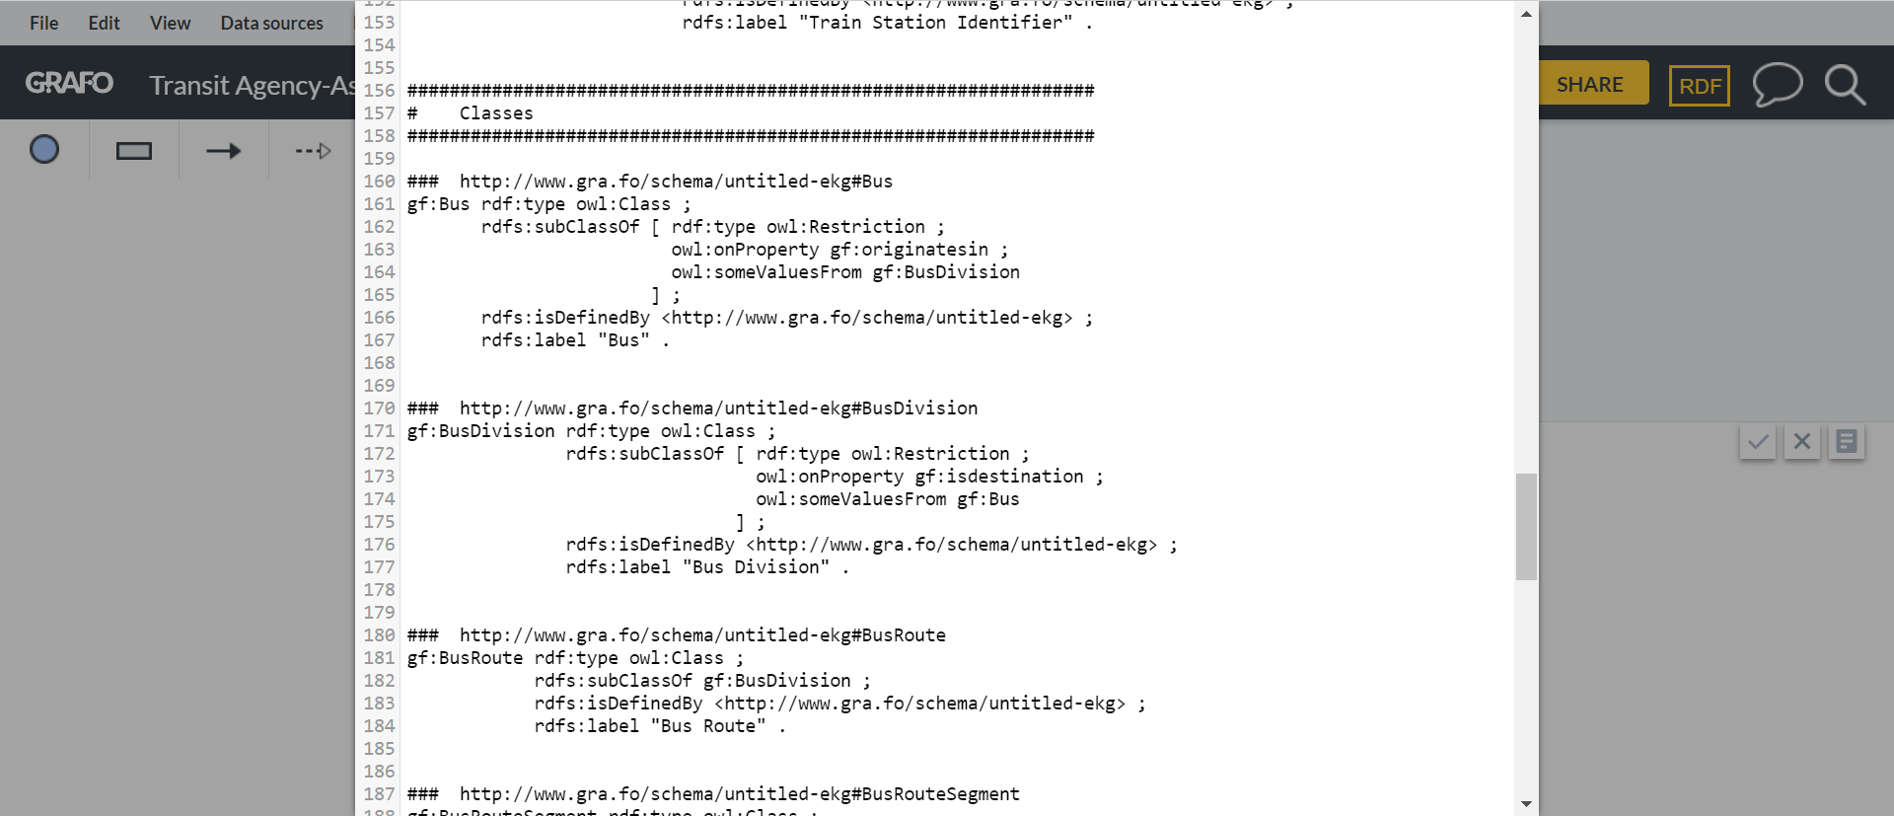
RDF behind the transportation asset graph
URI
URI
URI
URI

Slide 19
Summary of path to a transit agency knowledge graph
  Started as a project to digitize legacy paper records
  Generated separate metadata specs for each business unit
  But applied common naming conventions as much as possible
  Created a concordance of all the metadata attributes
  Generated examples of knowledge graphs that could be applied enterprise-wide

Slide 20
Knowledge graph vs. BPM
  The goal of a business process model is to specify a repeatable business process.
  A knowledge graph is about specifying named entities with attributes that facilitate the reliable retrieval of things.

Slide 21

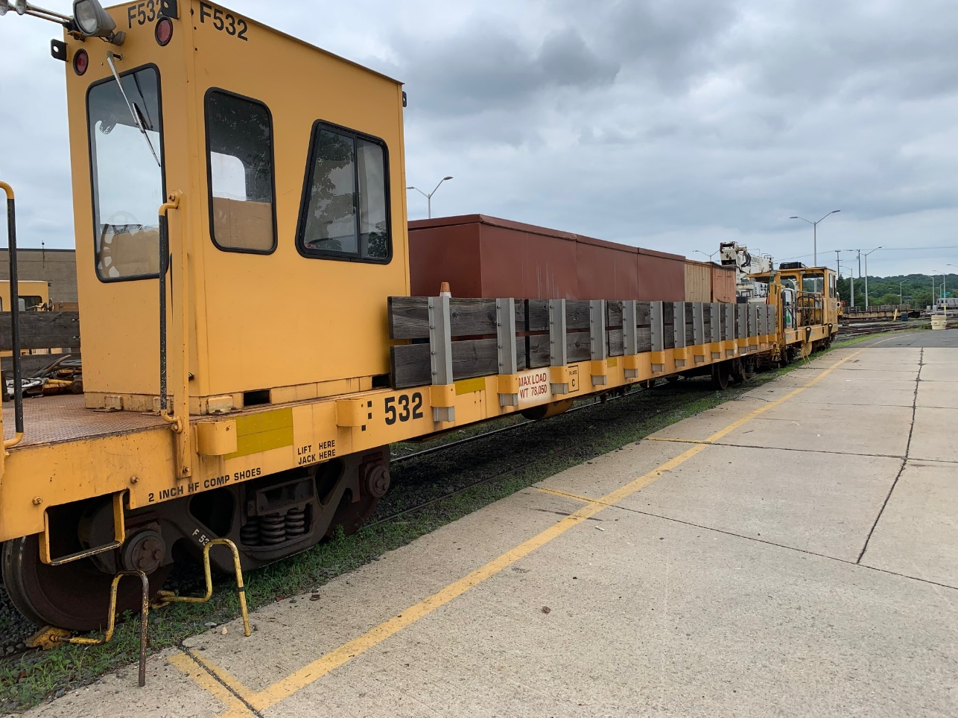
Questions
  Joseph Busch, Principal Consultant, jbusch@taxonomystrategies.com

